Slide 1


Productive Talk
about
Complex Text
Sarah Michaels
Clark University
Cathy O’Connor
Boston University
October 16, 2012

Slide 2
Productive Talk
about
Complex Text:
One Sentence
at a Time
Sarah Michaels
Clark University
Cathy O’Connor
Boston University
October 16, 2012

Slide 3
1. Talk and Learning (20 minutes)
2. What tools support academically (45 minutes) productive talk and discussion?
3. Working with complex text (40 minutes)
5. Questions and discussion (15 minutes)
In the next two hours:

Slide 4
Briefly, why aim for talk and discussion?
•Talk reveals understanding and misunderstanding.
• Talk supports academic language development.
• Talk supports deeper reasoning.
• Talk supports social development and perspective taking.

Slide 5
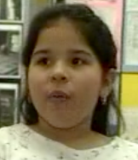
Why would talk support these outcomes?
•Information processing and
memory improve.
Hearing the words, phrases and sentences multiple times supports basic understanding and more robust memory…
Notes:
How? What are the mechanisms by which talk supports reasoning.

Slide 6

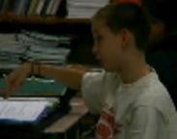
•Motivation improves.
I have a stake in this discussion…
•Understanding improves.
Detailed discussion of concepts and reasoning helps understanding…

Slide 7
In addition… it’s fundamental to the Common Core!
At the core of the Common Core (in ALL subjects):
Reasoning with evidence.
Building arguments and critiquing the arguments of others.
Developing rigorous, conceptually strong, evidence-based thinking practices.
Participating in reasoning-oriented practices, with others.
Notes:
At the core of the Common Core and Next Generation Science Standards…

Slide 8
Sounds great.
Nevertheless…
There are many obstacles.

Slide 9
We don’t have time!
What if no one talks?
I don't want to put them on the spot... some of my students are too shy to talk in front of everyone. Or they are ELs or have language-related problems.
“Fear of behavior”
What if Spencer just hogs the floor, as usual?
What if we get totally off track?
What if they bring up content that I don’t know what to do with?

Slide 10
I think teachers’ main anxiety is…
1. Time.
2. No one will participate.
3. Don’t want to put pressure them…
4. “Fear of behavior”
5. A few will take over.
6. We’ll get off track.
7. I won’t know what
to say about content

Slide 11
Getting past these obstacles…
1. Basic goals for discussion
2. Basic talk tools to achieve the goals:
talk moves and practices
3. Classroom norms that support respectful and equitable discussion
Notes:
We’re going to tell you about and demonstrate some of the ways we’ve been working with teachers to get past these obstacles, supporting them to think about (CLICK) basic goals for discussion, (CLICK) basic talk tools, and (CLICK) ways to build a classroom culture that supports respectful and equitable discussion.

Slide 12
And just to be clear, what is
“academically productive talk”?
(a.k.a. “accountable talk” or “discourse-intensive instruction”)

Slide 13
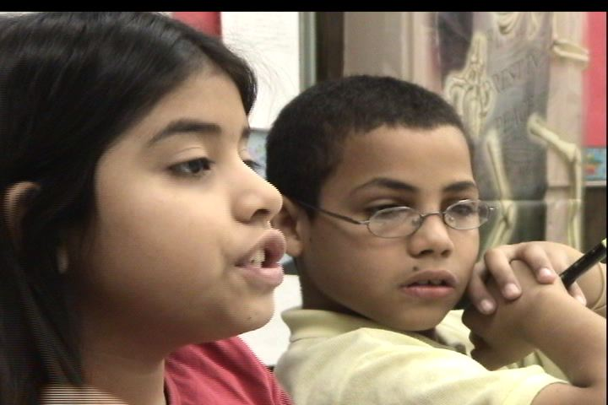
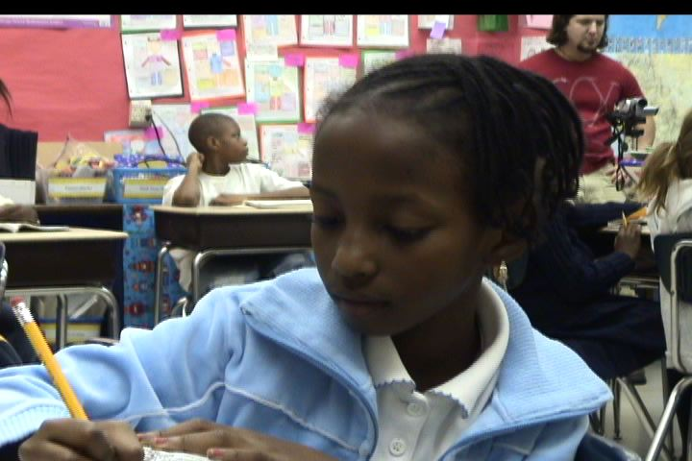
It is talk by teachers and students about academically important content:
Talk that supports development of student reasoning
Talk that supports improvement in students' ability to communicate their reasoning
Notes:
It’s important not to get hung up on the terminology – Accountable Talk, Academically Productive Talk -- Service Mark or not, it’s the same basic thing. Moreover,

Slide 14

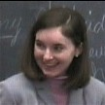
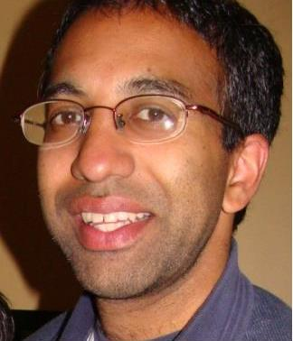
“I’ve been teaching this way all my life and I don’t call it anything.”
“Academically productive talk” or “Accountable Talk” is based on observations of teachers like these.
Notes:
We didn’t invent this. We learned it from extraordinarily successful teachers.

Slide 15
What about the research?
Do talk and discussion really support learning?
Notes:
Handout that summarizes and cites major studies – which you can use in presentations to others about the research evidence.

Slide 16
Research:
While there is typically lots of talk going on in classrooms, it is often not “productive” talk.
Teachers rely on recitation and
a few reliable talkers.
(Initiation – Response –Evaluation - the IRE)
T: What’s the capital of Indiana?
S: Indianapolis?
T: Good!
Notes:
Here’s the BAD news: This kind of discussion is not happening in most classrooms, even ELA classrooms. While there is often talk going on, it is often not “Productive Talk”. We know from Donna Alvermann’s work that many teachers say and think they’re doing discussion when they are not. And in Applebee’s large scale study of middle and secondary classrooms, he and his colleagues found there is an average of less than 2 minutes of discussion per hour in most ELA and social studies classes.
(CLICK) Teachers rely on recitation and a few reliable talkers. By recitation, I mean the IRE --

Slide 17
The bad news:
The dominant forms of talk in classrooms — recitation and direct instruction — do NOT support in-depth reasoning.
They do NOT support the building of arguments with evidence.
They do NOT support students to do the heavy lifting of explaining, critiquing, and thinking with their peers.
Notes:
If we are serious about promoting the thinking practices at the heart of each of these standards documents, we are going to need a dramatic change, really a sea change – in terms of the kind of classroom talk that teachers facilitate.

Slide 18
More bad news:
Teachers are not well-prepared (from their own experiences in school) to lead academically productive, reasoning-oriented discussions.
They often rely on group work, hoping that the hands-on activities, in small groups, will teach the students what they need to learn.

Slide 19
More bad news:
Even in good, NSF-funded math or science curricula, where the curriculum calls for “making meaning” discussions,
teachers have a hard time running the discussions. Discussions are often skipped. “…We just didn’t have time.”

Slide 20
Some good news:

Slide 21
Nystrand (1997) Opening Dialogue… (TC Press)
Study based on observations of >100 8th and 9th grade classrooms.
Findings: “Dialogic instruction” (discussion) is associated with better performance on end of year tests…
•More use of authentic questions, rather than “test” questions;
•More time for open discussion, whole-class discourse devoted to free exchange of ideas among students;
•More “uptake,” in which a teacher's question ”takes up” and builds on a student's previous comment.
Notes:
21
A large scale study by Nystrand –
And while this research is really compelling, it’s hard to make use of in the classroom. What are authentic questions? It can’t be right to tell teachers not to ask questions they know the answer to. What is meant by uptake? What does it look like?
Now shift to a few studies –two of which we were involved with – that showed in addition to impressive learning gains in the focal subjects (math, ELA or science) where talk was used, but also transfer to other subject areas as well.

Slide 22
Project Challenge
•4-year intervention led by Suzanne Chapin at Boston University
•Purpose: to provide challenging mathematics education for potentially talented students in Chelsea, MA, the lowest-performing district in the state.
•Project Challenge served over 400 Chelsea students, starting in 4th grade, following through until 7th grade.
•Over 70% of these students qualified for lunch aid, and over 60% spoke languages other than English at home.
Notes:
22
Project Challenge was a mathematics intervention in Chelsea, MA. The purpose was to provide challenging mathematics education for upper elementary and middle school students in Chelsea, which was, at the time, the lowest performing district in Massachusetts.

Slide 23
The intervention was multifaceted:
• One hour class every day
• TERC Investigations, Connected Math, Logic problems
• Monthly in-service professional development in math
• Expanded homework and weekly quizzes
• Consistent use of productive talk moves and frequent discussion.
Results?
Notes:
I’ll tell you much more about accountable talk.

Slide 24
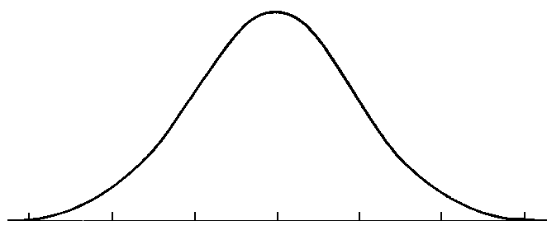
Results
In each cohort of 100, at the end of two and a half years, the class average on the California Achievement Test math portion was at the 90th percentile of a national norming sample.
90th percentile
California Achievement Test: Computation AND Concepts
Notes:
24

Slide 25
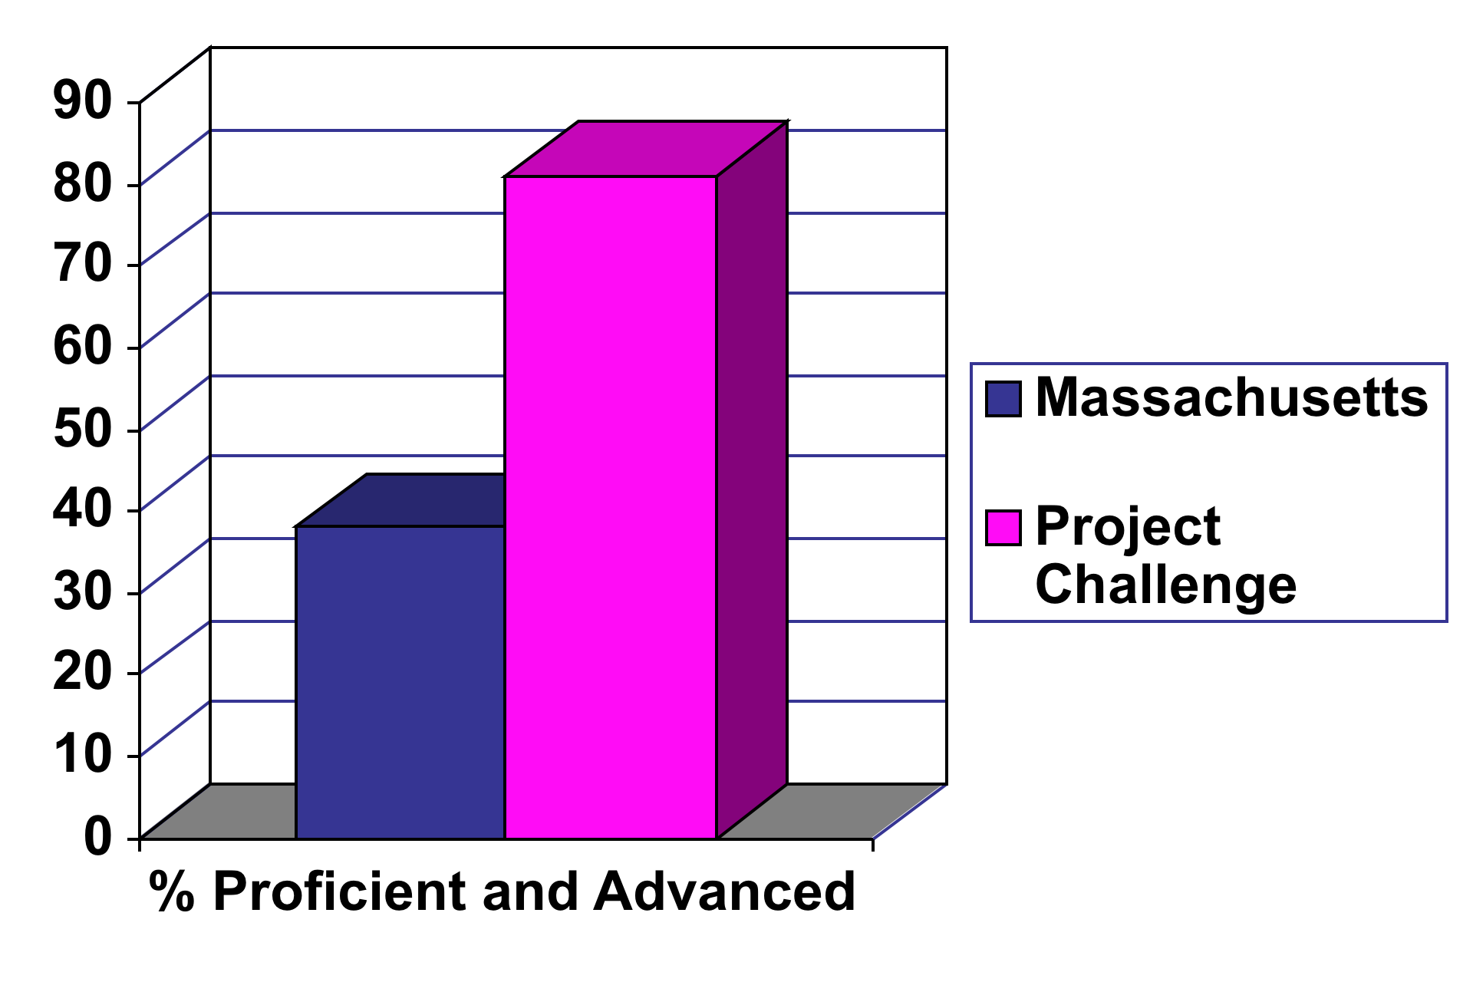
Results
At the end of three years, over 80% of each PC cohort scored as "Advanced" or "Proficient" on the MCAS math portion. (State average was 38%.)
Notes:
25

Slide 26
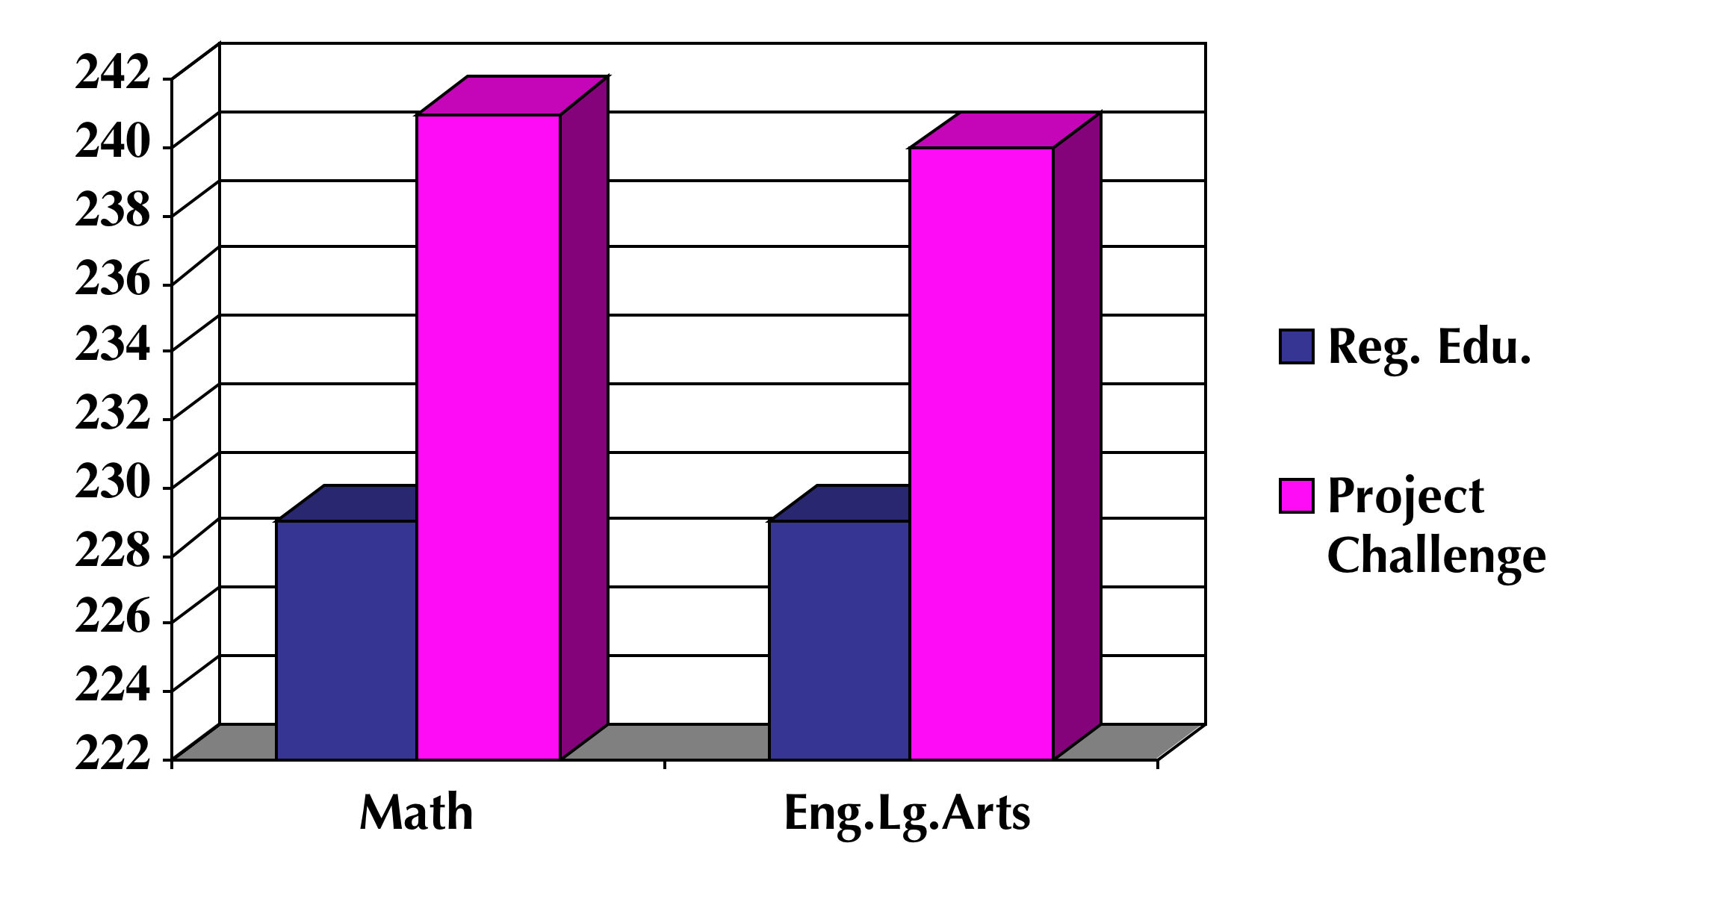
Results
And there were comparable gains in English Language Arts!
n=140
n=106
Notes:
26

Slide 27
Accountable Talk and
Junior Great Books Discussions at Community School 134 in the South Bronx
Notes:
The next example comes from Community School 134 in the South Bronx. In 2003, the teachers at CS 134 began implementing an approach to reading comprehension that drew on the principles of Accountable Talk to scaffold students’ deep engagement with challenging reading texts. The school adopted the Junior Great Books (JGB) curriculum and Shared Inquiry as the heart of the school’s Language Arts program. The specific focus of the intervention and teacher PD was on helping students learn to engage critically with challengings texts, weigh evidence, and explicate text-based arguments.

Slide 28
Community School 134
(George Bristow School)
South Bronx, New York
Population of 725 students, 99.8% free lunch eligible
  44.5% Black
  53.4% Hispanic
  9.2% English language learners
  5.9 % full time Special Ed.
Notes:
Community School 134 in the South Bronx has a student population that is 99.8% free lunch eligible.

Slide 29
Pre- and Post-intervention scores on
NY State ELA tests
Notes:
Aside from promoting discussion and reasoning in shared inquiry, the more immediate goal was to raise test scoresBefore the intervention, over 70% of the kids were below or far below standards. After implementing Shared Inquiry for only 6 months during the 2002-2003 academic year – CLICK -- the school’s test scores rose dramatically and these gains were maintained during the second year of the intervention, and the two years following the intervention. Unexpectedly, students’ standardized math scores at the school improved equally dramatically.

Slide 30
Pre- and Post-intervention scores on
NY State ELA tests
Notes:
The most important thing to note about the rise in test scores is that kids are moving out of Levels 1 and 2 (far below and below standards) and into Levels 3 and 4 (at or above standards). The history of test score rise in high poverty schools has been to move kids from failing to needs improvement (or from far below standards to below standards). It’s far more difficult to move kids out of level 2 and into proficient or meets standards. After only 6 months, the school went from over 70% below Basic, to over 50% meeting or exceeding standards.

Slide 31
Summing up the Research:
This body of work demonstrates that productive discussion, well-structured talk, produces robust learning. It actually helps “build the mind” — with long term benefits for thinking and achievement, which show up in standardized tests, transfer to other content domains, and persist over years.
Notes:
These are not the only studies that show this kind of dramatic learning with intense focus on reasoning-based, teacher-guided discussions. Take the handout.

Slide 32
So what is it that skilled teachers do to support productive talk and get past the obstacles?

Slide 33
Over the last two decades we have learned from many skilled teachers that there are FOUR IMPORTANT GOALS
that are necessary to create productive classroom talk and discussion.

Slide 34
If only one or two students can do this, you don’t have a discussion, you have a monologue or a dialogue.
Goal 1. Help individual students to share their reasoning so that it can be heard and understood.

Slide 35
Your ultimate goal involves sharing ideas, agreements and disagreements, arguments and counter-arguments, not simply a series of students giving their own, unconnected opinions.
Goal 2. Help students to orient to others and listen to what others say.

Slide 36
Good discussion keeps a focus on reasoning. The teacher must scaffold this consistently, getting students to dig deeper.
Goal 3. Help students to work on deepening their own reasoning.

Slide 37
Real discussion involves students actually taking up the ideas of other students, responding to them and working with them.
Goal 4. Help students to work with the reasoning of other students.

Slide 38
So how do these skilled teachers accomplish these goals?
4. Helping students to work with the reasoning of others.
3. Helping students to work on deepening their own reasoning.
2. Helping students to orient to others and listen to what others say.
1. Helping individual students to externalize their thinking– to share their reasoning out loud.

Slide 39
These things won’t happen consistently just by virtue of a good question, or an exciting topic.
4. Helping students to work with the reasoning of others.
3. Helping students to work on deepening their own reasoning.
2. Helping students to orient to others and listen to what others say.
1. Helping individual students to externalize their thinking– to share their reasoning out loud.

Slide 40
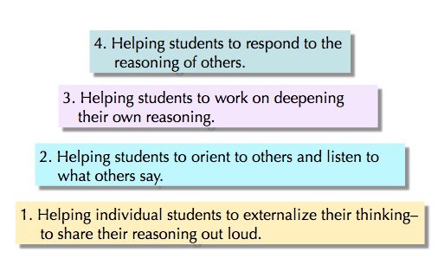
First, they used a variety of tools that helped them accomplish each of the four goals.

Slide 41
Second, the teachers we studied had set up classroom norms for using talk respectfully, and for ensuring equitable participation.

Slide 42
Third, the teachers we studied were able to integrate the content they taught into this discussion-friendly environment.

Slide 43
2. Tools
What tools help you accomplish the four goals to support productive talk and discussion?

Slide 44
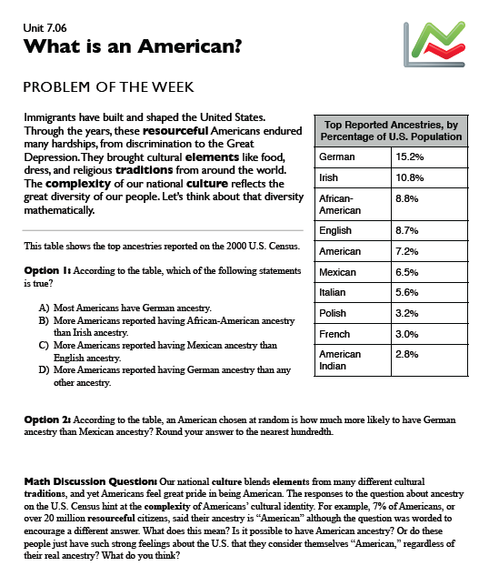
First, read the one-page “problem of the week”
(7-8th grade SERP Word Generation)

Slide 45
Discussion question:
Our national culture blends elements from many different cultural traditions, and yet Americans feel great pride in being American. The responses to the question about ancestry on the U.S. Census hint at the complexity of Americans’ cultural identity. For example, 7% of Americans, or over 20 million resourceful citizens, said their ancestry is “American” although the question was worded to encourage a different answer. What does this mean? Is it possible to have American ancestry? Or do these people just have such strong feelings about the U.S. that they consider themselves “American,” regardless of their real ancestry? What do you think?

Slide 46
Discussion usually starts
when the teacher poses
a specific question:

Slide 47
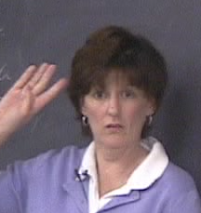
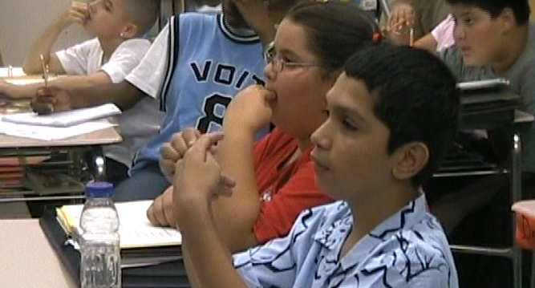
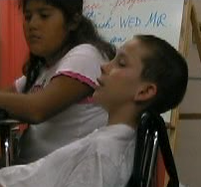
So why do you think some people would say that their ancestry is “American”?
What if the response is this:
24 blank faces. 1 or 2 hands up.

Slide 48
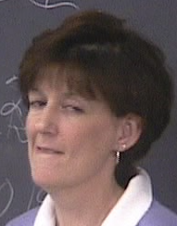
You think:
They need time to think! (and maybe time to practice what they want to say!)

Slide 49
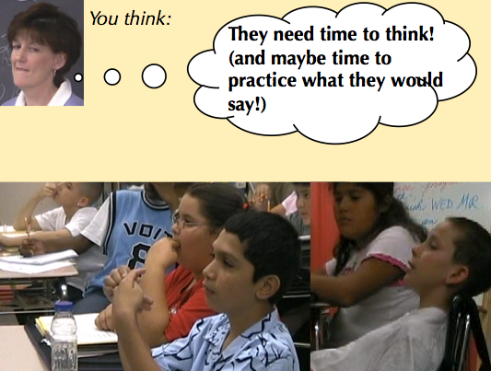
Tools: Wait time
        Stop and jot (60 seconds!)
Turn and talk (60 seconds!)
(Then ask the question again.)
Find this node on your Talk Moves Map

Slide 50
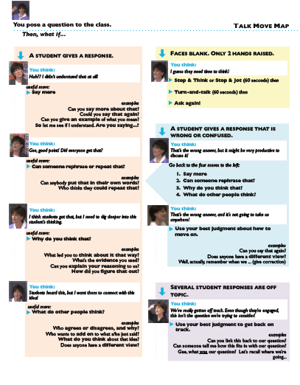
Find this node on your Talk Moves Map

Slide 51
So now why do you think some people would say that their ancestry is “American”? Who has an idea?
What if the response is this:
Javier: Well, the thing is, it’s not… American… like… yeah.

Slide 52
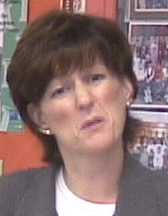
You think:
Huh?? I didn’t understand that at all!

Slide 53
Now what do I do? I don’t want to embarrass him, and I don’t want to feel like I’m putting him on the spot…

Slide 54
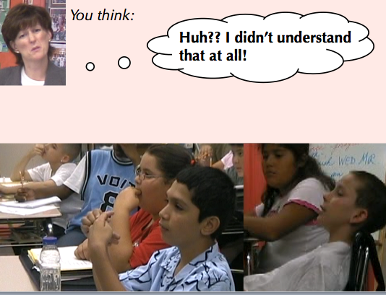
Useful talk tool:
“Say more…”
Can you say more about that?
Could you say that again?
Could you give us an example?
So let me see if I understand what you’re saying. Are you saying…?

Slide 55
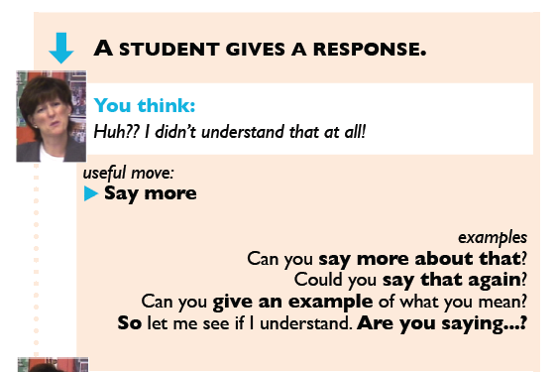
A closer look at one talk move…

Slide 56
So let me see if I understand what you’re saying. What you said was….
Is that right?
(Revoicing)
(Verifying and Clarifying)

Slide 57
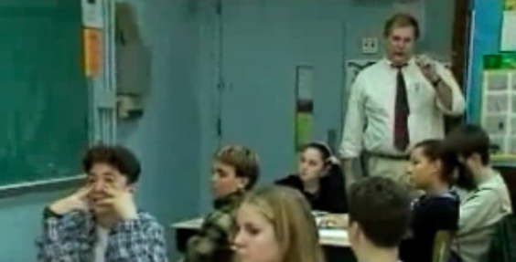
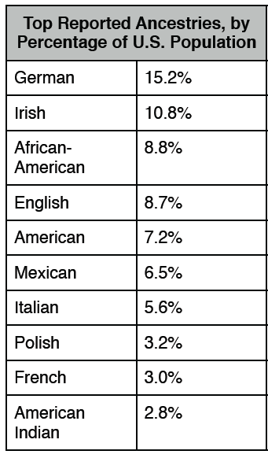
3.
The teacher has asked a question on the handout: Is it true that more Americans reported having Mexican ancestry than English ancestry?

Slide 58
3.
Elenor says “Yes, it IS true. It’s not…. I just… no. Yes, it’s true.”

Slide 59
3.
The teacher thinks “What?? Is she just not reading the table?”
But he decides to check– to verify and hopefully, clarify.

Slide 60
Teacher: So let me see if I understand. What you're telling me is that more people in this table chose Mexican than chose English for their ancestry? Is that what you’re saying?

Slide 61
Elenor: No, I read this thing? In the newspaper? About the recent census? And now more people choose Mexican than English. It’s a switch.

Slide 62
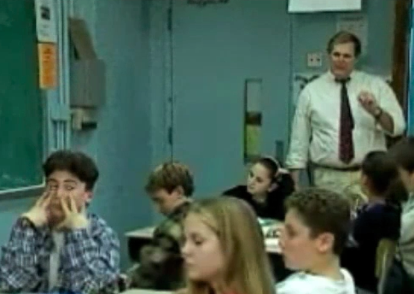
Teacher: Ohhh, I get it. You’re saying that the population has shifted in the last ten or so years. Is that right?
Elenor: Yeah. That’s what I read.

Slide 63
What is happening here?
•The teacher is confused at first, but then gets a clearer sense of what the student understands and doesn’t understand.
This is formative assessment at its best.

Slide 64
What is happening here?
• The student realizes that the teacher wants to understand her contribution.
The teacher doesn’t just assume that she is wrong.
Over time, this can have a profound effect.

Slide 65
What is happening here?
• The student can accept or reject the teacher's interpretation, which positions the student as a legitimate participant in the intellectual enterprise.

Slide 66
A simple but powerful talk move:
So you’re saying that _________?
Am I understanding you right?

Slide 67
OK, back to the question about the “Americans” in the census data…

Slide 68
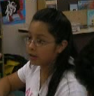
So now why do you think some people would say that their ancestry is “American”? Who has an idea?
Maybe you’ll get something like this:
Rita: Well, some people might ask why the government is asking what group they feel part of. They might not feel like part of any group? Like they might not really feel like they have an ancestry?

Slide 69
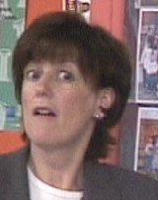
You think:
Wow! That’s good! But to talk about that, everybody has to hear it. Did everybody get it?

Slide 70
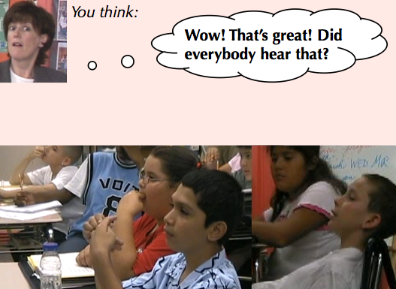
Useful talk tool:
“Can anyone rephrase or repeat that?”
Could somebody put that in their own words?
That had a lot of information in it. Who could repeat some of that for us?

Slide 71
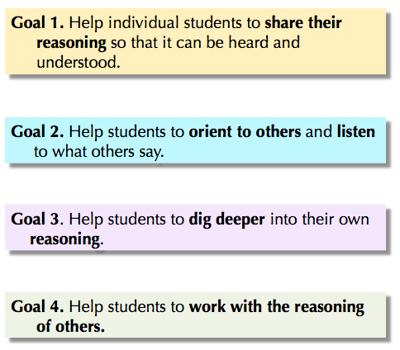
So why use this move?
Which of the four goals does it help you with?

Slide 72
Goal 2. Help students to orient to others and listen to what others say.
Goal 4. Help students to work with the reasoning of other students.
Note: it is not a good idea to start out using this move as a classroom management device, although that may be tempting.
This move is not about catching students who are not paying attention. It is best to always start with a student who wants to try to put another student’s contribution in their own words.

Slide 73
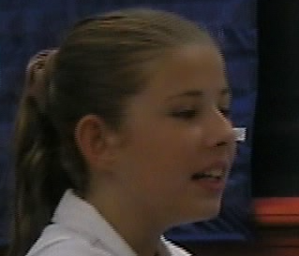
So now why do you think some people would say that their ancestry is “American”? Who has an idea?
Or you might get something like this:
Kimberly:
They just don’t know what to write.

Slide 74
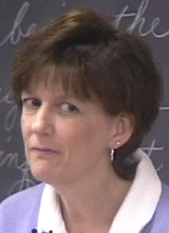
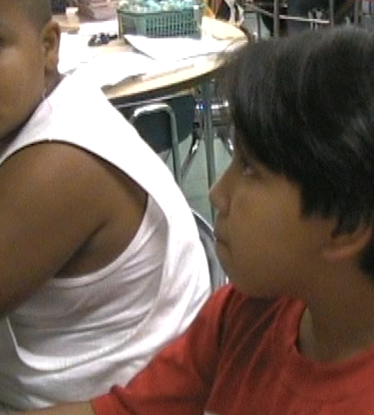
You think:
I think everyone heard that, but it’s kind of minimal. We need to dig deeper into her reasoning.

Slide 75
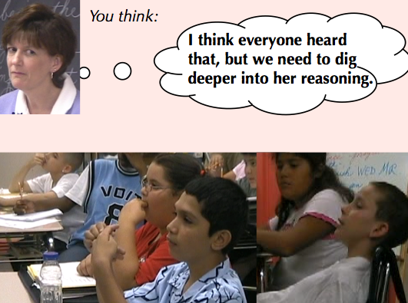
Useful talk tool:
“Why do you think
that?”
What’s your evidence?
Can you explain your reasoning to us?
How did you figure that out?
Did something in the text make you think that?

Slide 76
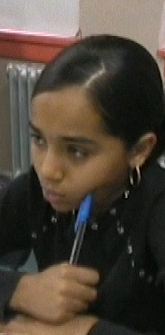
So now why do you think some people would say that their ancestry is “American”? Who has an idea?
Still another possibility: what if. . .
Jessica: It might be that they’re rejecting their culture, because they don’t want to be called that. Like…to avoid prejudice?

Slide 77
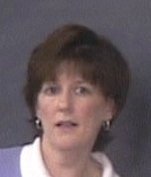
You think:
They heard her, and this is great discussion material. I want them to connect with her thinking!

Slide 78
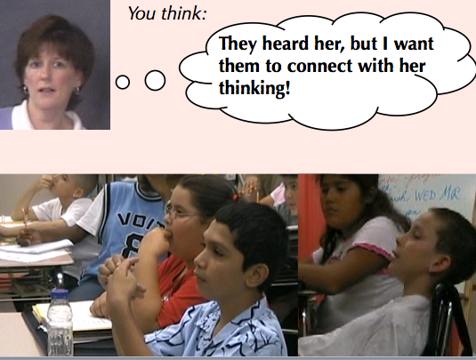
Useful talk tool:
“What do other
people think about
that?”
Who agrees or disagrees and why?
Who wants to add on to that?
Does anyone have a different view?
What do you think about that?

Slide 79
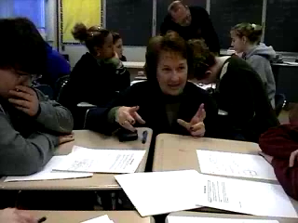
Agree or disagree and why?

Slide 80
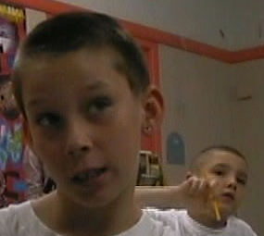
So now why do you think some people would say that their ancestry is “American”? Who has an idea?
Still another possibility: what if a student says…
James: Because they’re not… immigrants? They, like, their parents were born here?

Slide 81
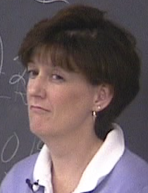
You think:
That’s not really on target, but it might be productive to discuss it…

Slide 82
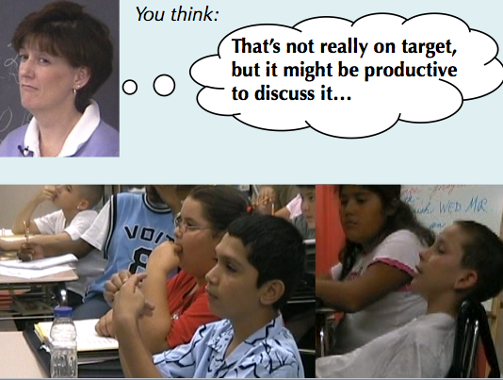
Cycle back to the four talk move families:
Say more
Can someone rephrase that?
Why do you think that?
What do other people think?

Slide 83
So now why do you think some people would say that their ancestry is “American”? Who has an idea?
Or what if a student says
JB: Does ancestry mean like your aunts? His aunts are American?

Slide 84
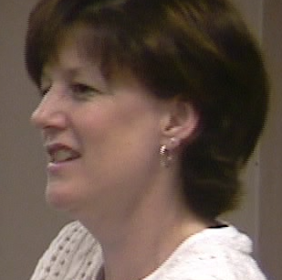
You think:
That’s wrong, and I don’t think it’s going to be helpful to discuss it right now…

Slide 85
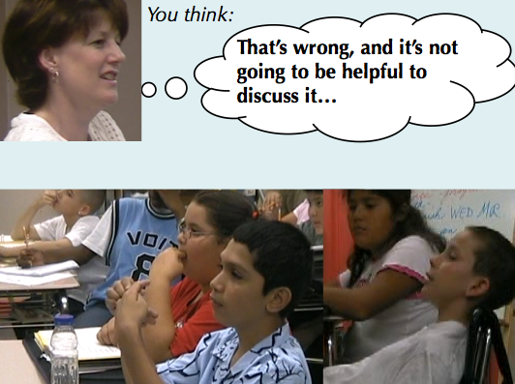
Use your best judgment about how to move on…
Well, actually…
(correct misunderstanding)
Repeat question

Slide 86
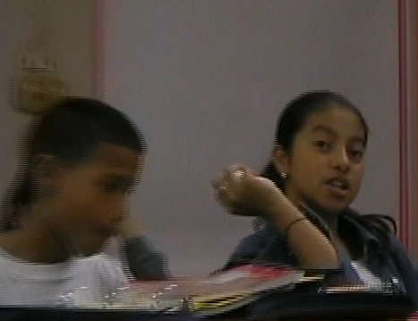
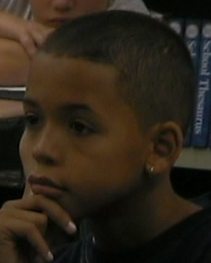
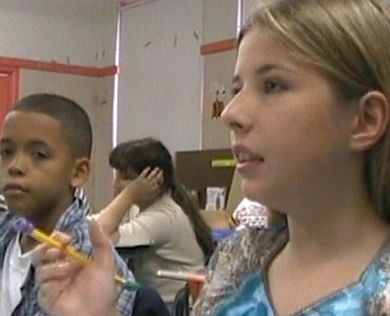
So now why do you think some people would say that their ancestry is “American”? Who has an idea?
Finally, what if…
Discussion ensues…
It’s going well… but soon, several students in a row contribute compelling personal narratives that are…
way off track!

Slide 87
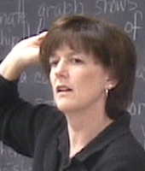
You think:
We’re way off track. They’re engaged, but this isn’t the question…

Slide 88
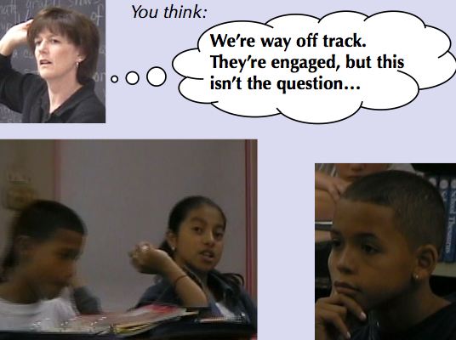
Use your best judgment about how to get back on track…
Can you link this back to our question?
Can someone tell us how this relates to our first topic?
Gee, what WAS our question? Who can remind us?

Slide 89
1. You ask: So now why do you think some people would say that their ancestry is “American”? Who has an idea?
Kalisha: Maybe their ancestors are Native American.
Your response:
____________________________________

Slide 90
1. Turn and Talk
2. Say More
3. Who can rephrase…?
4. Why do you think that?
5. What do others think?
6. Other
Kalisha: Maybe their ancestors are Native American.

Slide 91
3. You ask: So now why do you think some people would say that their ancestry is “American”? Who has an idea?
Christa: Well, my uncle is Puerto Rican, and he hates it when people don’t think he’s American.
Your response:
____________________________________

Slide 92
1. Turn and Talk
2. Say More
3. Who can rephrase…?
4. Why do you think that?
5. What do others think?
6. Other
Christa: Well, my uncle is Puerto Rican, and he hates it when people don’t think he’s American.

Slide 93
So these talk moves are tools that help you accomplish the goals that underlie productive discussion, whether it’s short or long.
Goal 1. Help individual students to share their reasoning so that it can be heard and understood.
Goal 2. Help students to orient to others and listen to what others say.
Goal 3. Help students to dig deeper in their own reasoning.
Goal 4. Help students to work with the reasoning of others.

Slide 94
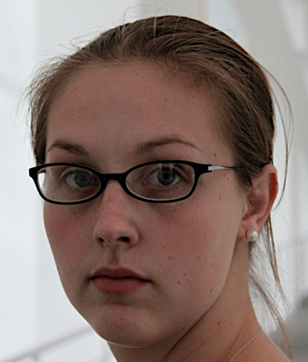
One more tool to help with all of these steps…
Using your ‘poker face’ and
your ‘poker voice’…

Slide 95
Your students have been primed all through their schooling to look at the teacher’s face and listen to the teacher’s voice for clues to what the right answer is.
When you scaffold a discussion, it will run aground if students simply look to you for the “right answer.”
Why? Because then they’re not looking towards the discussable issue and their own positions, they’re just looking to you.

Slide 96
So if you can keep yourself from saying “Good!” and “Right!” and “Try again…”
you’ll be giving your students a great gift.

Slide 97
Now we’ll show you a six minute video that is free on the web that introduces this material…

Slide 98
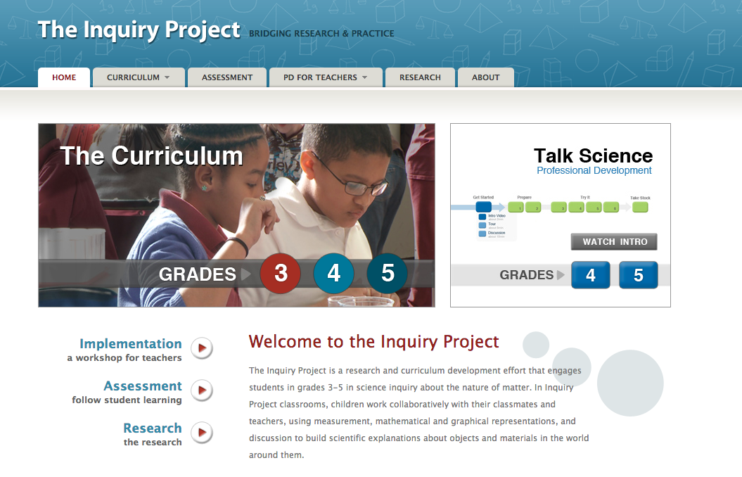
Talk Moves Overview video
www.inquiryproject.terc.edu
Notes:
Here’s just one example of the ways we help to make “talk moves” visible and useable -- as TOOLS that can transform the culture of talk, the mindset of the kids, and helping teachers position the kids as thinkers, so that they do more of the heavy lifting in building arguments and critiquing the arguments of their peers, with evidence.

Slide 99
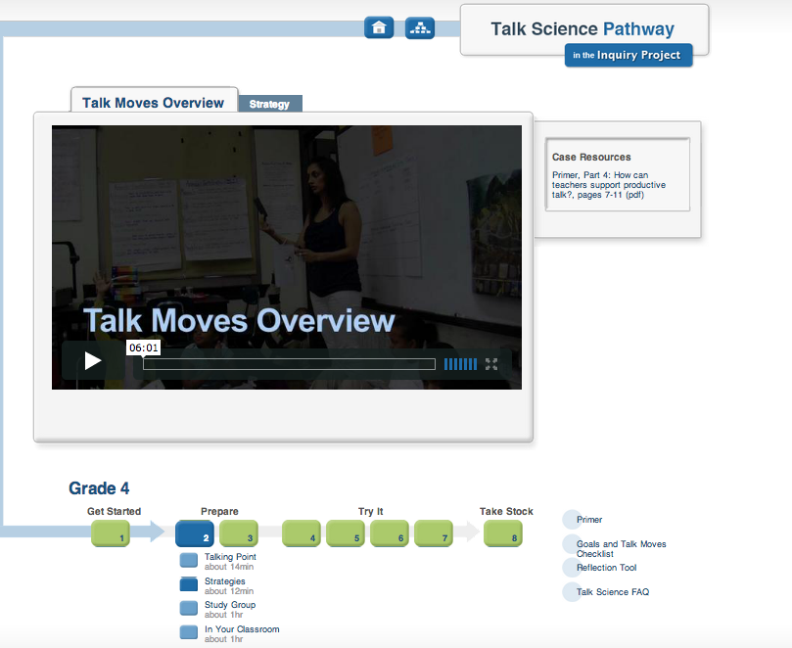
Notes:
Here’s just one example of the ways we help to make “talk moves” visible and useable -- as TOOLS that can transform the culture of talk, the mindset of the kids, and helping teachers position the kids as thinkers, so that they do more of the heavy lifting in building arguments and critiquing the arguments of their peers, with evidence.

Slide 100
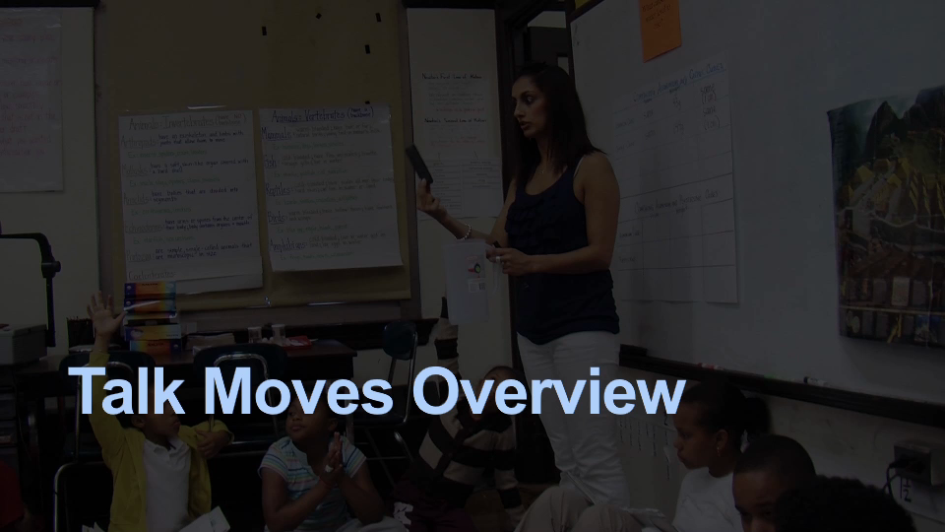

Slide 101
3. Using discussion to work with complex text, one sentence at a time.

Slide 102
Part One:
Simple steps in working through a complex sentence

Slide 103
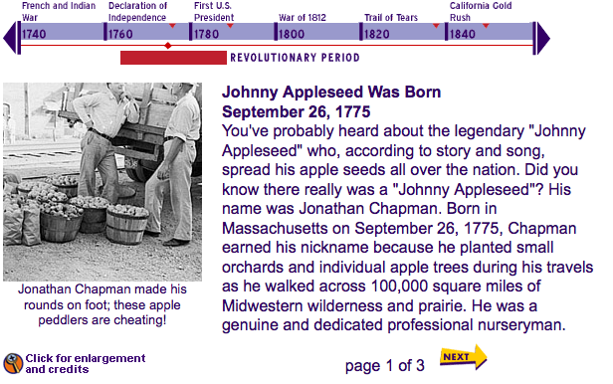
Example: a text about Johnny Appleseed
The original: retrieved from “America’s Story from America’s Library” The Library of Congress.
http://www.americaslibrary.gov/jb/revolut/jb_revolut_apple_1.html

Slide 104
¶1 You've probably heard about the legendary "Johnny Appleseed" who, according to story and song, spread his apple seeds all over the nation. Did you know there really was a "Johnny Appleseed"? His name was Jonathan Chapman. Born in Massachusetts on September 26, 1775, Chapman earned his nickname because he planted small orchards and individual apple trees during his travels as he walked across 100,000 square miles of Midwestern wilderness and prairie. He was a genuine and dedicated professional nurseryman.
…(¶2 deleted)
¶3 Chapman's work resembled that of a missionary. Each year, he traveled hundreds of miles on foot wearing a coffee sack with holes cut out for arms and carrying a cooking pot, which he is said to have worn like a cap over his flowing hair.
(127 Words)

Slide 105

Example: a text about Johnny Appleseed
A simplified version: retrieved from “The Weekly Reader (2008) http://www.weeklyreader.com

Slide 106
¶1 A man named Johnny Appleseed lived long ago. His real name was John Chapman. Why did people call him Johnny Appleseed? Let’s read the story to find out.
¶2 Johnny Appleseed was born in Massachusetts. He walked west across the country. He carried a sack of apple seeds. He planted seeds in Illinois, Indiana, Kentucky, Pennsylvania and Ohio.
¶3 Johnny did not have a home. He made clothes from sacks, and he did not have shoes to wear. As a hat, he wore a tin cooking pot. In fact, he used the pot for cooking!
(95 Words)

Slide 107
    Some people would argue that the simpler text is better for English Learners and students with reading difficulties.
    But this will leave them without the chance to get better at working with complex text.
    And many teachers who have to use the complex text will simply tell the students what it says.
So how do you actually work with students to break down the more complex text?

Slide 108
Chapman's work resembled that of a missionary.
Each year, he traveled hundreds of miles on foot wearing a coffee sack with holes cut out for arms and carrying a cooking pot, which he is said to have worn like a cap over his flowing hair.
2 sentences chosen at random from the complex version of Johnny Appleseed:

Slide 109
Chapman's work resembled that of a missionary.
Each year, he traveled hundreds of miles on foot wearing a coffee sack with holes cut out for arms and carrying a cooking pot, which he is said to have worn like a cap over his flowing hair.
Work with a partner to identify issues students might have with the language of these two sentences… (2 minutes)

Slide 110
Chapman's work resembled that of a missionary.
Each year, he traveled hundreds of miles on foot wearing a coffee sack with holes cut out for arms and carrying a cooking pot, which he is said to have worn like a cap over his flowing hair.
Work with a partner to identify issues students might have with the language of these two sentences… (2 minutes)

Slide 111
OK, so how do we start?
So let’s read this sentence out loud together.
OR: you read it first, then everyone reads it together.

Slide 112
Then, work your way through bit by bit…
“Chapman’s work resembled that of a missionary.”

Slide 113
Make sure people understand what the subject refers to…
“Chapman’s work resembled that of a missionary.”
So who has an idea about what the author means by “Chapman’s work”?

Slide 114
After that is clarified, make sure they understand the verb…
“Chapman’s work resembled that of a missionary.”
What is this word “resembled”?
(Discussion of word meaning, what kinds of things resemble what other kinds of things…)

Slide 115
Then put the whole sentence together again, repeating it:

Slide 116
Consider the phrase that comes after the verb:
“Chapman’s work resembled that of a missionary.”
What does that phrase mean?
“that of a missionary”?

Slide 117
Repeat the whole sentence again and ask for paraphrases…
His work resembled
“that of a missionary”…
Who has an idea about what that means?
Elicit three or four answers, and write them on the board.
Build common ground as you discuss them…

Slide 118
After that is clarified… put the whole thing back together one more time…
OK, let’s try to put this whole sentence together…
So who would like to put the sentence in their own words? Who thinks they can say what this whole sentence means using different words?
Collect at least 3 or 4 examples…

Slide 119
When you have the feeling that everyone “gets” this sentence...
Let’s read the sentence out loud again together.
Notes:
One technique is for every student to get a post-it and write down their name and what they think the sentence means in their own words – at the beginning – and then (on another post-it) after the discussion. This is incredibly helpful formative assessment for you.

Slide 120
Each year, he traveled hundreds of miles on foot wearing a coffee sack with holes cut out for arms and carrying a cooking pot, which he is said to have worn like a cap over his flowing hair.
Longer sentences with more complex structure may require a few more discussion prompts:

Slide 121
Each year, he traveled hundreds of miles on foot wearing a coffee sack with holes cut out for arms and carrying a cooking pot, which he is said to have worn like a cap over his flowing hair.
Work with a partner and find the big chunks you would start with (2 minutes):

Slide 122
    >>Each year, he traveled hundreds of miles on foot
    >>wearing a coffee sack with holes cut out for arms
    >>and carrying a cooking pot,
    >> a cooking pot, which he is said to have worn like a cap over his flowing hair.
One reasonable approach:

Slide 123
After reading the whole sentence through, make sure everyone knows who the subject refers to…
“Each year, he traveled hundreds of miles on foot...”
So who is “HE” here?

Slide 124
And make sure that everyone understands the predicate:
“Each year, he
traveled hundreds of miles on foot...”
And what do they mean by “traveled hundreds of miles on foot”?

Slide 125
    >>Each year, he traveled hundreds of miles on foot
    >>wearing a coffee sack with holes cut out for arms
    >>and carrying a cooking pot,
    >> a cooking pot, which he is said to have worn like a cap over his flowing hair.
Then you can add in the first modifying phrase, putting it together with the main clause:

Slide 126
Let’s add in the next part--
“Each year, he traveled hundreds of miles on foot wearing a coffee sack with holes cut out for arms”
Who can say this in a different way?
Collect at least 3 or 4 versions…

Slide 127
Then move on to the next part…
Let’s look at the rest!
“and carrying a cooking pot, which he is said to have worn like a cap over his flowing hair.”
What picture is the author trying to give us?
Solicit at least 2 or 3 versions…

Slide 128
After everyone understands the gist, take time to home in on tough phrases…
Now here’s something confusing:
“and carrying a cooking pot, which he is said to have worn like a cap …”
Does anyone have a hypothesis about that part?

Slide 129
Then what?
OK, this sentence says a lot. Who can tell us one thing you learned from this sentence?
Collect at least 3 or 4 examples… perhaps write them on the board.

Slide 130
Johnny Apple walked for hundreds of miles and he wore a sack.
Johnny Appleseed had long hair.
He always carried a coffee pot.
So where did you find your information in this sentence?

Slide 131
Each year, he traveled hundreds of miles on foot wearing a coffee sack with holes cut out for arms and carrying a cooking pot, which he is said to have worn like a cap over his flowing hair.
Johnny Apple walked for hundreds of miles and he wore a sack.
Johnny Appleseed had long hair.
He always carried a coffee pot.
So where do you find your information in our sentence?

Slide 132
Simple steps in working through a complex sentence
1. Choose a complex sentence ahead of time;
2. Decide on chunks; note complex parts.
3. In class: Read sentence aloud (together).
4. Identify the meaning of the subject.
5. Identify the meaning of the predicate.
Keep building common ground…
6. Discuss the meaning of each chunk;
Keep building common ground…
7. Keep going until the entire sentence is generally understood.
8. Ask for reformulations, paraphrases, what was learned.
9. Link paraphrases to original sentence.
10. Read the sentence aloud again, together.

Slide 133
A great formative assessment tool: at the start of the sentence discussion--
Take a post-it note and write down what you think this sentence means. Then we’ll do this again after we’ve talked about the sentence.
Notes:
One technique is for every student to get a post-it and write down their name and what they think the sentence means in their own words – at the beginning – and then (on another post-it) after the discussion. This is incredibly helpful formative assessment for you.

Slide 134
What you’ve done here is help students get practice digging into complex text,
one complex sentence at a time.

Slide 135
Part two:
Managing discussions about complex text using talk moves

Slide 136
Even if you understand how to break up complex sentences and work with them, you still have to contend with what students will say!

Slide 137

CCSR for English Language Arts and Literacy in History/Social Studies, Science, and Technical Subjects
Grades 6-8 Text Exemplars:
“The evolution of the grocery bag” by Henry Petroski

Slide 138
¶1
That much-reviled bottleneck known as the American supermarket checkout lane would be an even greater exercise in frustration were it not for several technological advances.
The Universal Product Code and the decoding laser scanner, introduced in 1974, tally a shopper’s groceries far more quickly and accurately than the old method of inputting each purchase manually into a cash register.
But beeping a large order past the scanner would have led only to a faster pileup of cans and boxes down the line, where the bagger works, had it not been for the introduction, more than a century earlier, of an even greater technological masterpiece: the square-bottomed paper bag.
✔

Slide 139
We start by reading the whole sentence aloud…
That much-reviled bottleneck known as the American supermarket checkout lane would be an even greater exercise in frustration were it not for several technological advances.

Slide 140
Wow. That’s a mouthful. Let’s draw a line under the subject of the sentence:
That much-reviled bottleneck known as the American supermarket checkout lane

Slide 141
That much-reviled bottleneck known as the American supermarket checkout lane
So what does that mean?? Who has an idea?
24 blank faces. 1 or 2 hands up.

Slide 142
You think:
They need time to think! (and maybe time to practice what they want to say!)

Slide 143
Talk to the person next to you… what do you think this is talking about? See what you can make out of this…
That much-reviled bottleneck known as the American supermarket checkout lane

Slide 144
So what does that mean? Javier, did you two come up with something?
Javier: It’s something about the checkout line in the store.

Slide 145

OK, it’s telling us something about the checkout line at the store. Who can add on to that?
Marta: Something about the bottles?

Slide 146
What makes you think it’s about bottles? What information are you basing that on?
Marta: Right there where it says “That much revealed bottleneck known as the American supermarket checkout line.”

Slide 147

OK, so we’re seeing that word “bottleneck.” What IS a bottleneck? Has anybody used that word?
Wayne: I heard of a bottleneck in traffic. Like all the cars getting stuck going over the bridge. But not at a supermarket.

Slide 148
So a bottleneck is like a place where things get stuck? Is that what you’re saying?
Wayne: Well, yeah, and there’s like a back-up or a slow-down or something.

Slide 149
So what is this saying? What’s the subject here? This is complicated. Let’s look at this again:
That much-reviled bottleneck known as the American supermarket checkout lane
Talk to the person next to you and see if you can put it into your own words.

Slide 150
There’s a bottleneck at the supermarket checkout line.
Maybe people get backed up at the checkout in the store because there’s too many of them.
The checkout line at stores will slow you down when you want to pay for your stuff.

Slide 151
(Discussion of word meaning ensues, including exploration in the dictionary)
There’s a word here nobody has mentioned…
what is “reviled”?
It says the much-reviled bottleneck…
Discussion keeps building common ground…

Slide 152
Finally, we get to the predicate!
OK, so now we know what the subject phrase means...
let’s see if we can figure out the whole sentence!

Slide 153
Go back to the next chunk of the sentence…
That much-reviled bottleneck known as the American supermarket checkout lane would be an even greater exercise in frustration …

Slide 154
Whew. So that’s just the subject…
But over time, 10 minutes a day on a complex sentence adds up. Students have more stamina for understanding complex texts… they know it takes work.

Slide 155
And as their knowledge of complex structures in written English improves, they can take on more complex texts themselves. And they can produce more complex sentences.

Slide 156
Time for questions and comments…

Slide 157
Thank you!
mco@bu.edu
smichaels@clarku.edu

