Slide 1
Inclusion of Students with Disabilities and English Learners in PARCC Assessments
Council of Great City Schools
May 2, 2013
Tamara Reavis, Senior Adviser, Achieve

Slide 2
Today’s Charge
Discuss developments made in creating accessible assessments and inclusive policies for students with disabilities and English learners taking the PARCC assessments

Slide 3
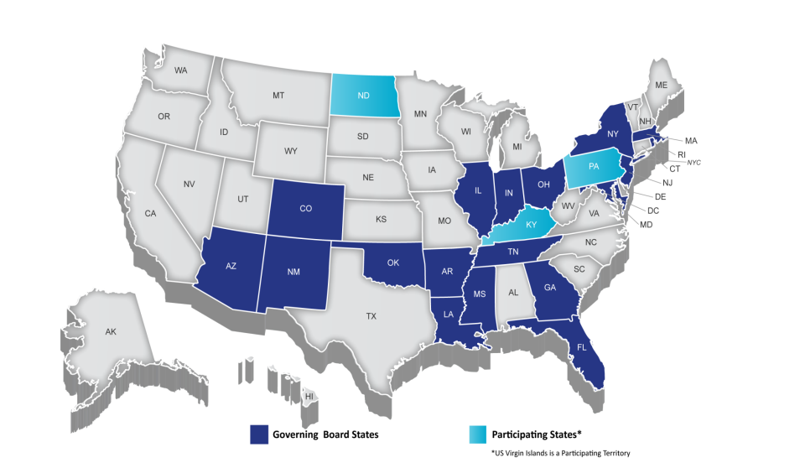

Partnership for Assessment of Readiness for College and Careers (PARCC)
Notes:
TALKING POINTS
PARCC is an alliance of 22 states, educating nearly 25 million students, that are working together to develop a common set of K-12 assessments in English and math anchored in what it takes to be ready for college and careers. PARCC is led by 18 governing board states (and D.C.) represented in Dark Blue.
CLICK: The chair of the governing board is Mitchell Chester, Education Commissioner of Massachusetts, and the state of Florida is serving as its fiscal agent.
CLICK: Achieve is the project manager for PARCC, essentially serving as the staff for the consortium and coordinating the work. Collectively the PARCC states educate nearly 25 million students.
Governing States will pilot and field test the assessment system components over the next three years and administer the new assessment system during the 2014-15 school year. Governing States will use the results from the PARCC assessments in their state accountability systems
The chief state school officers of the Governing States serve on the PARCC Governing Board and make decisions on behalf of the Partnership on major policies and operational procedures
Participating States (light blue) provide staff to serve on PARCC’s design committees, working groups, and other task forces established by the Governing Board to conduct the work necessary to design and develop PARCC’s proposed assessment system. By 2014–15, any state that remains in PARCC must commit to statewide implementation and administration of the Partnership’s assessment system Any PARCC Participating State prepared to make the commitments and take on the responsibilities of a Governing State can become one
NOTES
Governing Board: Comprised of K-12 chiefs from Governing Board States
Technical Advisory Committee: Comprised of state/national assessment experts
Leadership Team: Comprised of delegates of K-12 chiefs from Governing Board States (e.g., Assoc. Supt for Curriculum, Assessment and/or Instruction)
ACCR: Comprised of national and state postsecondary leaders
Operational Working Groups: Comprised of national, state, and local experts and leaders in their specific areas of expertise

Slide 4
PARCC Priorities
Determine whether students are college and career ready or on track
Connect to the Common Core State Standards
Measure the full range of student performance, including that of high- and low-achieving students
Provide educators data throughout the year to inform instruction
Create innovative 21st century, technology-based assessments
Be affordable and sustainable
Notes:
PARCC will develop an assessment system comprised of four components. Each component will be computer-delivered and will use technology to incorporate innovations.
Two summative, required assessment components designed to:
Make “college- and career-readiness” and “on-track” determinations,
Measure the full range of standards and full performance continuum, and
Provide data for accountability uses, including measures of growth.
Two non-summative, optional assessment components designed to:
Generate timely information for informing instruction, interventions, and professional development during the school year.
A third non-summative component in English language arts/literacy will assess students’ speaking and listening skills

Slide 5

How Will PARCC Be Different?
Students: Will know if they are on track
to graduate ready for college/careers
Teachers: Will have access to timely
data to guide learning and instruction
Parents: Will have clear and timely
information about student progress
States: Will have valid results that are comparable across borders

Slide 6
Getting All Students College and
Career Ready
K–2
Grades 3–8
High
School
Ongoing student support/interventions
Success In
first-year, credit-bearing, postsecondary coursework
Voluntary K–2 assessment being developed, aligned to the Common Core State Standards
Timely data showing whether ALL students are on track for college and career readiness
College readiness score to identify who is ready for college-level coursework
Targeted interventions and supports:
State-developed 12th-grade bridge courses
Professional development for educators

Slide 7


Assessments
ELA/Literacy and Mathematics, Grades 3–11
Beginning of School Year
End of
School Year
Flexible administration
Diagnostic
Assessment
Mid-Year Assessment
Performance-Based
Assessment
End-of-Year
Assessment
Speaking and Listening Assessment
Key:
Optional
Required

Slide 8


Access & Equity
Notes:
TAKLING POINTS: All students will have equitable opportunities to access and respond to PARCC assessment items and tasks.

Slide 9
Strategies for Increasing Student Access
Provide item developers with clear guidelines for writing items that are free of bias, are sensitive to diverse cultures, are stated clearly, and use consistent formats
Require item developers to use principals of Universal Design to allow participation of the widest possible range of students, and increase the likelihood that test questions measure only what they are intended to measure
Conduct bias and sensitivity reviews and statistical procedures that are designed to detect bias as part of the item development/field testing process
Develop common test accommodation and participation policies for SWDs and ELLs
Use technology to provide and increase access to testing accommodations
Conduct research to determine factors that promote or hinder accessibility

Slide 10
Designing Accessible Assessments:
Key PARCC Deliverables
Selected Key Deliverables
Bias & Sensitivity Guidelines for item development
Accessibility Guidelines for item development
Item & Passage Review Committees; Bias & Sensitivity Review Committees
Participation guidelines for SWD & EL (common definition)
Item Tryouts; Item Development Research Studies; Field Testing
PARCC Common Accommodations Manual
Research & Cross-Consortia Collaboration
INCREASING EQUITY AND ACCESSIBILITY FOR ALL STUDENTS

Slide 11
Draft PARCC Accommodations Manual

Slide 12
What’s Included in the Manual
The draft PARCC Accommodations Manual is a comprehensive policy document that will support local educators in the selection, administration, and evaluation of accommodations for the assessment of students with disabilities (SWD) and English learners (ELs) on the computer-delivered PARCC End-of-Year, Performance-Based, and Mid-Year Assessments.
The Manual provides educators with information on the accommodations which, when used on the PARCC End-of-Year, Performance-Based-Assessment, and Mid-Year assessment, will result in a valid score for a student.
Notes:
The majority of the proposed accommodations policies are currently in use across PARCC states.
Different from many current state accommodations manuals, however, the draft PARCC manual includes not only proposed participation and accommodations policies for SWD and ELs, but also information about tools that will be provided through PARCC’s computer-based assessment delivery system for all students to optimize their performance on the assessments.
By assessing students on computers, PARCC states will now have the opportunity to provide all students with tools they frequently use in the classroom and daily life that were once provided only as accommodations for SWD and ELs (e.g. highlighters and enlarged font).

Slide 13
What’s Coming
Manual is a proposed policy document, so full administrative guidance is not included in the document at this time.
Summer 2013, PARCC states and key stakeholders will review and vet a number of appendices to the Manual which will be designed to support states and districts in the implementation of the policies.
Additional supports coming summer/fall 2013:
  PARCC Test Administration Manual
  PARCC Style Guide
  Online professional development module on accommodations policies
  State-level professional development on selecting, administering, evaluating, and monitoring accommodations
Accommodations policies for the Speaking & Listening and Diagnostic Assessments

Slide 14
First Edition
Draft represents best thinking of the PARCC states to date, in consultation with PARCC’s state expert working groups on accessibility, accommodations and fairness; technology; ELA/literacy; and mathematics, as well as national experts.
Draft has support of majority of PARCC states but not complete consensus. Public comment is intended to shape first edition.
Future editions will be drafted based on upcoming field tests, research, and operational testing.
Focus is on accessibility and accommodations for computer-delivered Performance-Based, End-of-Year, and Mid-Year PARCC assessments in mathematics & ELA/literacy.

Slide 15
Development & Review
Manual was developed and reviewed over the past year through an iterative process involving the following groups:
  State experts serving on the PARCC Accommodations, Accessibility and Fairness Operational Working Group;
  K-12 PARCC State Leads;
  Additional state agency experts (including special education and English learner experts);
  External experts, including English learner expert Lynn Shafer Willner, the National Center on Educational Outcomes (NCEO) and the PARCC Technical Working Groups on Equity, English Learners and Students with Disabilities;
  National advocacy groups for SWD, ELs, and equity and fairness; and
  Staff from PARCC’s project management partner Achieve.

Slide 16
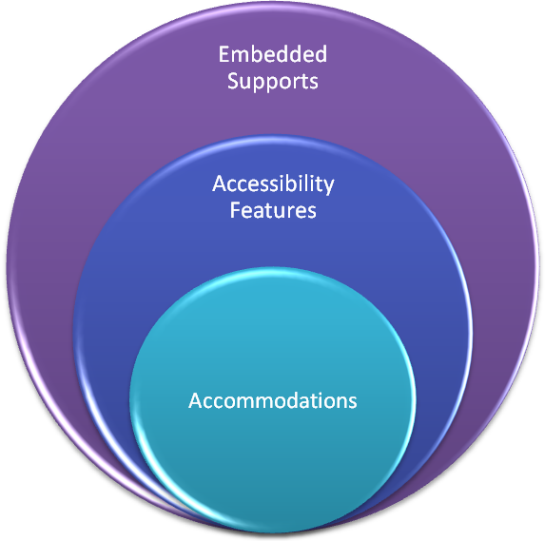
PARCC Comprehensive Accessibility Policies
Notes:
The draft Manual details a three-tiered process to providing access to the assessments for all students:
Embedded Supports: Tools embedded in the computer-delivered system available to all students to use (e.g. font magnification, highlighting tool, bolding, underlining)
Accessibility Features: Tools embedded in the computer-delivered system open to all students to use, but must be made available at the discretion of school-based educators (e.g. background/font color, answer masking)
Accommodations: Supports for SWD and ELs that increase access while maintaining a valid and reliable score (e.g. braille form, extended time, small group testing, word-to-word native language dictionary)

Slide 17
Proposed Embedded Supports
Tool, support, scaffold, or preference that is built into the assessment system that can be activated by any student, at his or her own discretion.
Universal Design features expected to benefit a diverse array of students and are available to all students.
Provided onscreen, stored in a toolbar, or are accessible through a menu or control panel, as needed.
During the assessment, students can choose which embedded supports they need for specific items. Examples include: audio amplification, highlighting, pop-up glossary, etc.

Slide 18
Proposed Embedded Supports
Embedded Supports
Audio Amplification
Blank Paper (not embedded)
Eliminate Answer Choices
Flag Items for Review
General Administration Directions Read Aloud and Repeated as Needed
Highlight Tool
Magnification/Enlargement Device
Noise Buffers
NotePad
Pop-Up Glossary
Redirect Student to Test (not embedded)
Spell Checker
Writing Tools

Slide 19
Proposed Accessibility Features
Available to all students (i.e., not limited to students with IEPs, 504 plans, or ELs), but will be selected and “turned on” by a school-based educator prior to the assessment, based on each student’s Personal Needs Profile (PNP).
Based on each student’s individual needs, a PNP is created for the student to ensure that he or she receives appropriate access without the distraction of other tools and features that are not required by the student.
Although a school-based educator will enable specific accessibility features for students, the student will decide whether or not to use the feature. Accessibility features will be readily available on the computer-delivered testing platform.
Notes:
Individualizing access needs for the assessment provides increased opportunities for each student to accurately demonstrate knowledge and skills, and will reduce the chances of giving students incorrect accommodations or supports on the day of the test. Examples of accessibility features include: answer masking, background/font color, line reader, etc.

Slide 20
Proposed Accessibility Features
Accessibility Features
Answer Masking
Background/Font Color (Color Contrast)
General Administration Directions Clarified (must be done by human test administrator)
Line Reader Tool
Masking
Text-to-Speech for the Mathematics Assessments

Slide 21

Proposed
Accommodations for SWD

Slide 22
Proposed Accommodations for SWD
Category | Accommodation
Presentation | Assistive Technology
 | Braille Edition (Hard Copy – ELA/Literacy & Math; Refreshable – ELA/Literacy
 | Closed-Captioning of Video
 | Descriptive Video
 | Familiar Test Administrator
 | Paper-Pencil Edition of the ELA/Literacy and Math Assessments
 | Tactile Graphics
 | Video of Human Interpreter for Math Assessments (deaf or hard-of-hearing)
 | Video of Human Interpreter for Test Directions (deaf or hard-of-hearing)
Response | Assistive Technology
 | Braille Note-taker
 | Scribing/Speech-to-Text for the Mathematics Assessments
Timing & Scheduling | Extended Time
 | Frequent Breaks
 | Time of Day
Setting | Adaptive or Specialized Furniture
 | Separate or Alternate Location
 | Small Group
 | Special Lighting
 | Specified Area or Preferential Seating

Slide 23
Proposed Special Access Accommodations (SWD)
Special Access Accommodations (SWD)
Calculation Device
Read Aloud or Text-to-Speech for the ELA/Literacy Assessments, including items, response options, and passages
Scribe or Speech-to-Text (i.e., Dictating/ Transcription) for the ELA/Literacy Assessments
Video of a Human Interpreter for the ELA/Literacy Assessments, including items, response options, and passages for a student who is deaf or hard of hearing
Word prediction on the ELA/Literacy Performance-Based Assessment

Slide 24
Public Comment on Special Access Accommodations – Responses & Considerations

Slide 25
Major Themes from Winter 2013 Public Comment on Special Access Policies
Restrictiveness
Child characteristics/preferences
Conditions for provision of accommodation
Construct validity
Grade span issues
Violates IEP/child’s rights/IDEA
Impact on students
Vagueness of policy and eligibility criteria

Slide 26
PARCC Responses to Public Comments for Special Access Accommodations
Added claims language upfront in the assessment design section
Noted, where appropriate, students on 504 accommodation plans.
Revised “eligibility” language – “Proposed Decision-Making Guidance for IEP and 504 teams”
Refocused Manual around computer-delivered assessments
Provided guidance on the decision-making process and how it relates to assessment policies
In summer 2013, PARCC states and key stakeholders will review and vet a number of appendices designed to support states in the implementation of the policies mentioned in the Manual for release.
Met with stakeholder and advocacy groups to discuss final draft Manual prior to public comment

Slide 27
Proposed Accommodations Policies for ELs
Notes:
TALKING POINTS

Slide 28
Proposed Guidance on Selecting Accommodations for ELs
When selecting accommodations for ELs, consider the student’s:
  . Level of English language proficiency (ELP) on the state ELP test
    Beginning, Intermediate, or Advanced
  . Literacy development in the native language
    Native language literacy
    Interrupted schooling/literacy background
  . Background factors that impact effective accommodations use
    Grade/age
    Affective filter (i.e., level of student anxiety/comfort with English)
    Time in U. S. schools

Slide 29
Mapping Accommodations to ELP
WIDA ACCESS for ELLs® English Language Proficiency (ELP) Levels |  | ELDA English Language Proficiency Levels |  | Composite ELP Level (Acosta et al., 2008)
Level 1 | Entering | Level 1 | Pre-Functional | Beginning
Level 2 | Emerging | Level 2 | Beginning
Level 3 | Developing | Level 3 | Intermediate | Intermediate
Level 4 | Expanding | Level 4 | Advanced Intermediate
Level 5 | Bridging | Level 5 | Advanced | Advanced
Level 6 | Reaching | Level 6 | Full English Proficiency not exited
Notes:
Appropriate accommodations enable ELs to more effectively demonstrate their knowledge of the content. Because EL status itself is transitional in nature, there are accommodations specific to ELs that provide different degrees and types of linguistic support to ELs as they progress through beginning, intermediate, and advanced levels of English language proficiency.
Many States currently use WIDA ACCESS for ELLs and ELDA ELP assessments to determine English language proficiency. To meet U.S. Department of Education Flexibility Waiver requirements, many States are or will be implementing new ELP/ELD standards in the next two years.
As a result, the ELP performance level descriptors in this chart will be updated to align with States' new ELP/ELD Standards.
Proposed guidance for selecting EL accommodations on PARCC assessments will use a composite ELP level that aligns with current WIDA ACCESS and ELDA levels.

Slide 30
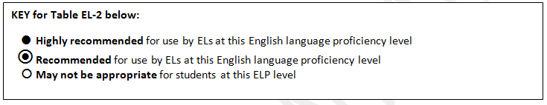
Proposed Accommodations for ELs
Accommodation | Beginning | Intermediate | Advanced
English/ Native Language Word-to-Word Dictionary (ELA/Literacy & Mathematics) |  | • | •
Test Directions clarified by test administrator in student’s Native Language (ELA/Literacy & Mathematics) | • | ◉ | 
Read Aloud or Text to Speech: Test items and response options read aloud in English (ELA/Literacy) | • | ◉ | 
Scribe or Speech-to-Text: Responses Dictated for Mathematics assessment in English (Mathematics) | • | ◉ | 
Extended Time (ELA/Literacy and Mathematics) | • | • | •
Frequent Breaks (ELA/Literacy and Mathematics) | • | • | •

Slide 31
Providing Feedback on the Draft PARCC Accommodations Manual
Notes:
TALKING POINTS

Slide 32
Public Comment Period
Draft PARCC Accommodations Manual is open for public comment from April 18 – May 13, 2013.
Please read the full draft PARCC Accommodations Manual and Frequently Asked Questions prior to providing feedback via the public survey.
To submit feedback on the Manual, please go to the PARCC website and click on the feedback survey links (one for English learners and one for students with disabilities): http://www.parcconline.org/parcc-assessment-policies
If you would like to submit feedback on both policies for English learners and students with disabilities, please fill out two separate surveys.

Slide 33
Manual Development Timeline
Activity | Date
Early research and development phase | June 2011 – January 2013
Draft reading access & calculator accommodations policies released for public comment | January 16 – February 4, 2013
National SWD and EL Stakeholder Briefing | January 18, 2013
Draft writing access accommodations policies released for public comment | February 8 – 20, 2013
1st draft of PARCC Accommodations Manual for SWD & ELs sent reviewed by states | March 12, 2013
Accessibility, Accommodations and Fairness national technical experts discussed Manual | March 14, 2013
PARCC State Lead Review | March 20-27, 2013
Follow-up meetings with advocacy/national organizations providing public comments | March 27 – April 20
Executive Committee discussion and vote to move to public comment | April 10
Public comment on the Draft Accommodations Manual for SWD & ELs | April 18 – May 13
Draft PARCC Accommodations Manual revised in response to feedback | May 14 – June 11, 2013
Governing Board vote on adoption of PARCC Accommodations Manual (First Edition) | June 26, 2013
PARCC Accommodations Manual (First Edition) released | Summer 2013
Second edition of PARCC Accommodations Manual released after field testing and item development research studies | Late 2013-early 2014

Slide 34
Inclusion of Students with Disabilities and English Learners in PARCC Assessments
Council of Great City Schools
May 2, 2013
Tamara Reavis, Senior Adviser, Achieve
treavis@achieve.org

